Slide 1

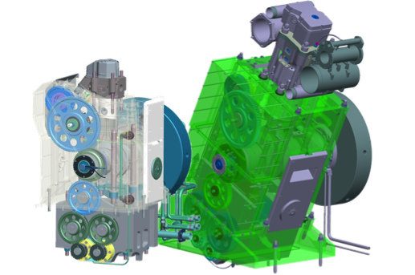
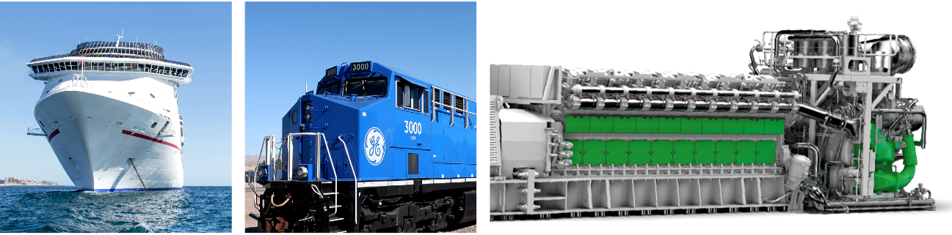

Large Engines Competence Center
Experimental Evaluation and Quasi-dimensional Modeling of Hydrogen Combustion for Sustainable Maritime Applications
Markus Roßmann
17 June 2020 • N. Wermuth, M. Lackner, M. Roßmann, J. Zelenka, A. Wimmer, M. Url, W. Fimml

Slide 2
Agenda
Introduction and objectives
Approach
Simulation procedure
Results
Conclusion and outlook
Notes:
First i will give a short introduction and explane the objectives of this study.
After explaining the experimental and modelling approaches i will show our simulation procedure
Finally i will show some results of this study and give an short outlook

Slide 3
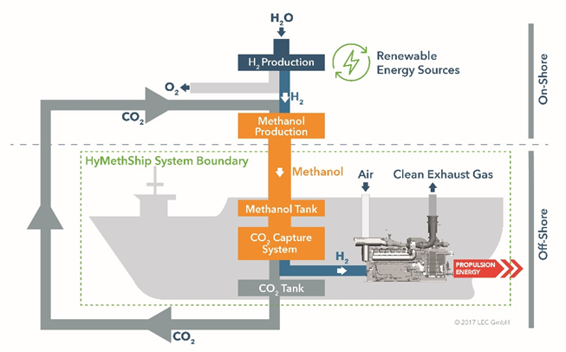
Introduction
The HyMethShip project
Combining methanol steam reforming, a CO₂ capture system and a hydrogen-fueled ICE
Emissions reduction
  97% reduction in CO₂ emissions
  Elimination of SOx and PM emissions
  Reduction of NOx emissions
Notes:
This Study was part of the HyMethShip project – a cooperative R&D project funded by the European Union’s Horizon 2020 research and innovation program
The HyMethShip system innovatively combines a membrane reactor, a CO₂ capture system, a storage system for CO₂ and methanol as well as a hydrogen-fueled combustion engine into one system. The system reforms methanol to hydrogen, which is then burned in a conventional reciprocating engine that has been upgraded to burn multiple fuel types and specially optimized for hydrogen use.
The renewable methanol fuel bunkered on the ship is ideally produced on-shore from the captured CO₂, thus closing the CO₂ loop from the ship propulsion system.
The HyMethShip system will achieve a reduction in CO₂ of more than 97% and will practically eliminate SO_{x} and PM (particulate matter) emissions. NO_{x} emissions will be reduced by more than 80% significantly below the IMO Tier III limit.

Slide 4
Objectives
Enhance the understanding of hydrogen ignition and combustion in large bore, high-speed engines
Developement of a heat release model for hydrogen combustion that can be used for:
  NO_{x} emissions predictions
  1D simulation-based performance optimization

Slide 5
Agenda
Introduction and objectives
Approach
Simulation procedure
Results
Conclusion and outlook

Slide 6
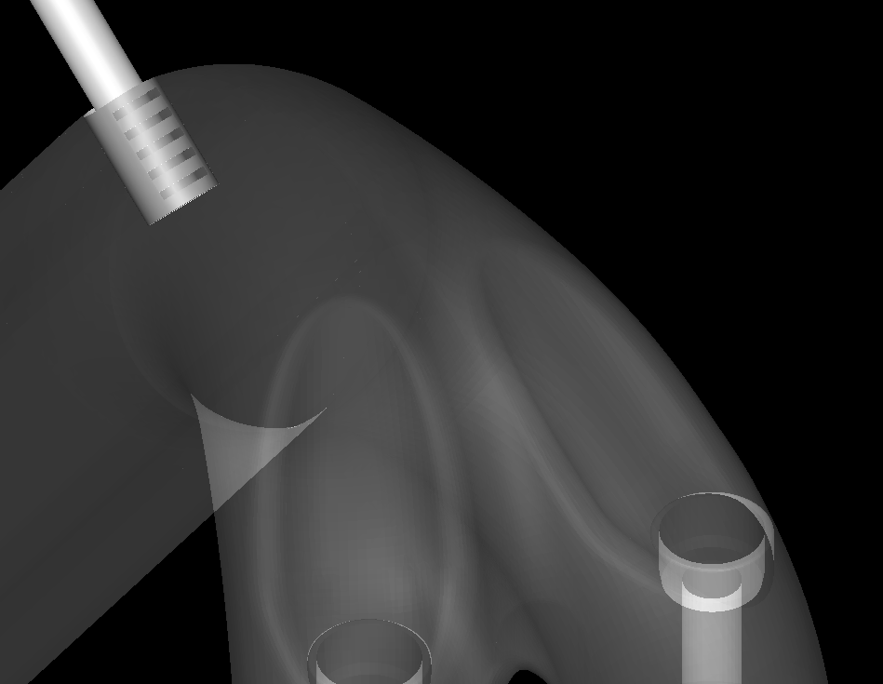
Experimental approach
Engine Testing
Experimental investigations on a high-speed 4-stroke single cylinder engine
Open chamber configuration with centrally mounted spark plug and Port fuel injection
Variation of excess air ratio(EAR) and ignition timing(IT) for selected indicated mean effective pressure(IMEP)
Data Processing:
  Heat release analysis was performed using the in-house simulation and analysis tool LEC CORA
Intake port
Hydrogen injection nozzle
Intake valve guides
Notes:
The first step was to execute Experimental investigations on a high-speed 4-stroke single cylinder engine
Therefore a Open chamber configuration with centrally mounted spark plug and Port fuel injection
To study the impact on combustion and emission formation as well as To get a high number of operating points for the developement of the heat release model, the key operating parameters EAR and ignition timing for were varied for selected IMEP at constant speed
After the engine testing, Heat release analysis was performed using the in-house simulation and analysis tool LEC CORA

Slide 7
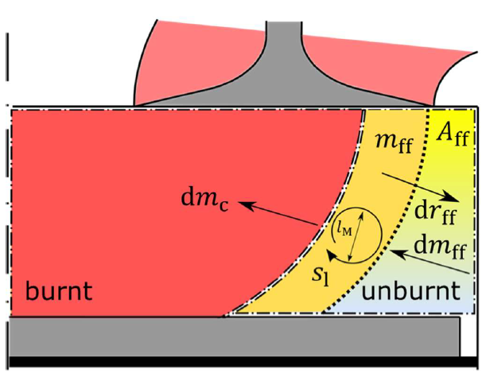
Modeling approach
Open chamber combustion model (OCM)
Combustion chamber divided in 3 zones
  Burned zone
  Unburned zone
  Flame front
Several sub-models to describe flame entrainment, the flame front, squish flow and turbulence
Laminar flame speed
  Calculation with chemical kinetics software Cantera
dm_{c}…mass flow to burned zone
dm_{ff}…mass flow to flame front
ff…flame front
Notes:
For the Modeling, a heat release model based on well-established natural gas open chamber combustion models was seleceted and modified for hydrogen combustion.
This quasi-dimensional model can be devided into 3 zones.
The instantaneous burn rate is described by the fuel mass available in the flame front.
The OCM considers the in-cylinder flow field and the combustion chamber geometry and consists of several sub-models to describe flame entrainment, the flame front, squish flow and turbulence
The 0D combustion model relies on accurate laminar flame speed data. Because no existing Model showed satisfying conformity to Hydrogen, LFS was calcu-lated with the chemical kinetics software Cantera and tabulated for use in the OCM simulation. The calculation was performed with the USC reaction mechanism und validated with published experimental data
The OCM can be adjusted to the experimental heat release rate with several model parameters, which will be explained later

Slide 8
Agenda
Introduction and objectives
Approach
Simulation procedure
Results
Conclusion and outlook

Slide 9
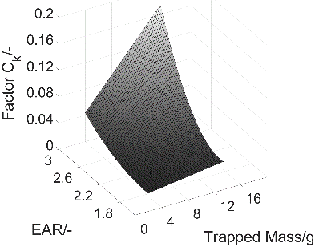
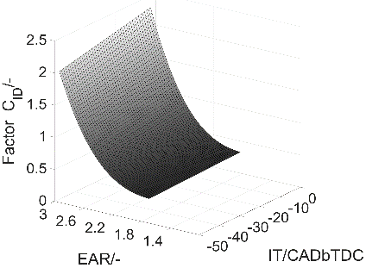
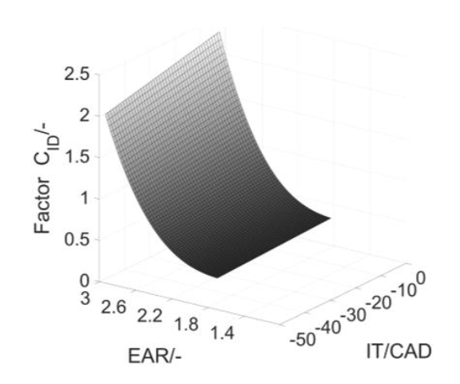
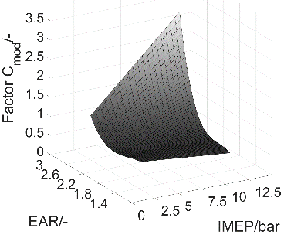
Simulation Procedure
Correlation between OCM parameters and engine operating conditions
Turbulent kinetic energy factor C_{k} | Ignition delay factor C_{ID}
Combustion factor C_{mod} | Integral length scale factor C_{L}
 | constant
High-pressure cycle analysis of selected engine operating points
Initial simulation parameters
(wall heat transfer coefficient, gas composition, geometry, LFS)
0D combustion simulation with OCM
Experimental HRR
Simulated HRR
Agreement
Adjustment of model and simulation parameters
No
Yes
Establish correlations between OCM parameters and engine operating conditions
Notes:
The following procedure was used to adjust the open chamber combustion model to Hydrogen combustion from the experimental investigations
The first step was, to perform a high-pressure cycle analysis of selected engine operating points.
The simulation parameters consist of results from the measurement analysis, like wall heat transfer coefficients, gas compositions and engine geometry
After the simulation with LEC CORA, the Simulated HHR is compared to the Experimental Data.
The adjustment of model parameters is performed based on the least squares method with additional constraints for deviations from measured IMEP, NOx emissions, MFB50% and in-cylinder temperature at the opening of the exhaust valve
Finally, correlations between OCM parameters and engine operating conditions, e.g. IMEP, EAR and IT, shown on the right side were established.

Slide 10
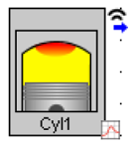
Simulation Procedure
1D engine simulation
Engine performance simulations using the 1D simulation tool GT-Power
OCM included as a user defined function
User model = OCM
Combustion object
Simulated HRR
p, T, NO_{x},…
Notes:
Finally Engine performance simulations using the 1D simulation tool GT-Power was excuted
The OCM, including the correlations for all model parameters, was implemented into an existing single-cylinder GT-Power model as a user defined function
Input data for the OCM, e.g. wall temperatures and heat transfer coefficient, are specified within the engine cylinder module and passed on to the combustion model
The simulated HHR is then used in the engine cylinder module to perform the 1D Simulation
The Results were then compared to measurement data and 0D Simulation

Slide 11
Agenda
Introduction and objectives
Approach
Simulation procedure
Results
Conclusion and outlook

Slide 12

Experimental results
Combustion-related measurement data
ID decreases with lower EAR and later IT
STD‘s of MFB50% and MFB90% increase with later IT for a constant EAR and for leaner mixtures
STD of ID shows minor dependence on IT
EAR = 2.25 EAR = 2.50 EAR = 2.75
ID/CAD
STD_ID/CAD
MFB5%/CAD
STD_MFB5%/CAD
MFB50%/CAD
STD_MFB50%/CAD
MFB90%/CAD
STD_MFB90%/CAD
- - - - -
- - - - -
IT/CAD
IT/CAD
$$Ignition Delay ID=MFB5\%−IT$$
$$Burn Duration BD=MFB90\%−MFB5\%$$
Notes:
First i will present experimental results of hydrogen combustion investigations
This result shows the key combustion metrics ID, MFB5%, MFB50%, MFB90%, for ignition timing variations with different EAR at a high load engine operating condition.
Igintion delay is defined as the time from the ignition timing to 5% Mass fraction burnt. The Burn duration is calculated with MFB90%-MFB5%
On the left-hand side average values of 60 consecutive combustion cycles are shown. Standard deviations (STD) are displayed on the right-hand side. As expected, The ID decreases with lower EAR and later IT
In contrast to the coefficient of variation (COV) of IMEP that was shown to increase with later ignition timing in previous studies, the standard deviation of the ID shows only a minor dependence on ignition timing and remains at a rather large value. The standard deviations of MFB50% and MFB90% increase with later IT IT for a constant EAR and for leaner mixtures. Late MFB90% and high standard deviation might indicate that cycles with slow combustion exist.

Slide 13
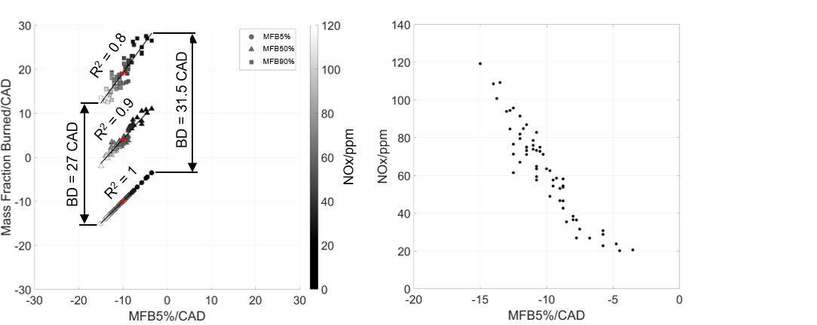
Experimental results
Individual cycle hydrogen combustion
Analysis of individual cycles
Wide spread of MFB90%
  combustion duration only varies in a narrow range
MFB5% has a strong correlation with MFB50% and MFB90%
Early combustion cycles disproportionately contribute to overall NOx formation
Notes:
The next step was the Analysis of individual cycles .
The Investigation shows that while MFB90% shows a wide spread, the combustion duration only varies in a narrow range from 27 to 31.5 CAD. Cycles with late MFB90% show a longer burn duration as is expected due to decreasing pressures and temperatures during the expansion stroke.
There is a strong correlation between MFB5% and MFB50% as well as between MFB5% and MFB90%. No individual cycles were observed where the combustion progressed slowly after a short ID and early MFB5%, leading to the conclusion that ignition phase offers the largest potential to reduce cyclic variability for hydrogen combustion.
In the lower figure the NOx formation is estimated for each individual cycle based on the HRR and displayed over MFB05%. The early combustion cycles disproportionately contribute to overall NOx formation. A narrower spread of the ID and the combustion phasing could potentially facilitate a reduction of NOx emissions.

Slide 14
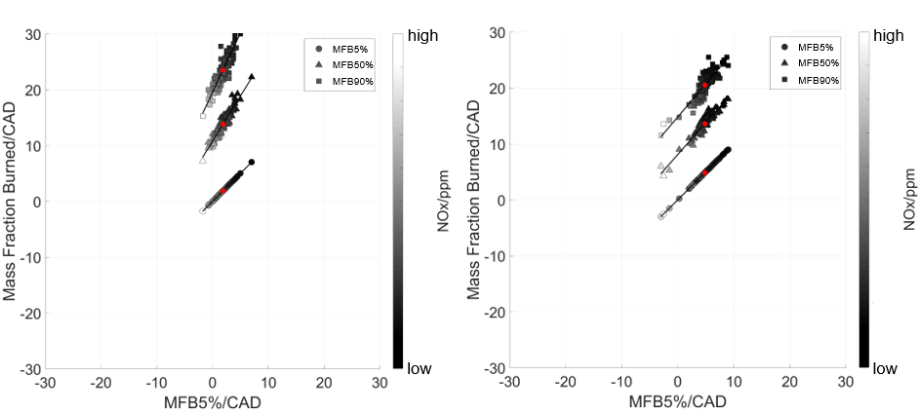
Experimental results
comparision of different large bore engines
Natural Gas
IT 24 CAD before TDC
Hydrogen
IT 6 CAD before TDC
Ignition timing for hydrogen operation is significantly later than for the natural gas operation
→ The spread of MFB5% and ID is larger for the hydrogen operation
Notes:
The next figure shows combustion parameters at constant MFB50% for different large bore gas engines with open chamber
On the left-hand side key combustion parameters for individual cycles in natural gas operation are shown, while on the right-hand side the results from hydrogen operation are displayed
This figure shows Another indication that using hydrogen as a fuel leads to a larger spread in the combustion phasing
Even though the ignition timing for the hydrogen operation is significantly later than for the natural gas operation, the spread of MFB5% and therefore ID is larger for the hydrogen operation. At this point it is unclear if the observed ignition behavior is mainly caused by the hydrogen properties or if mixture inhomogeneities also play a role.

Slide 15
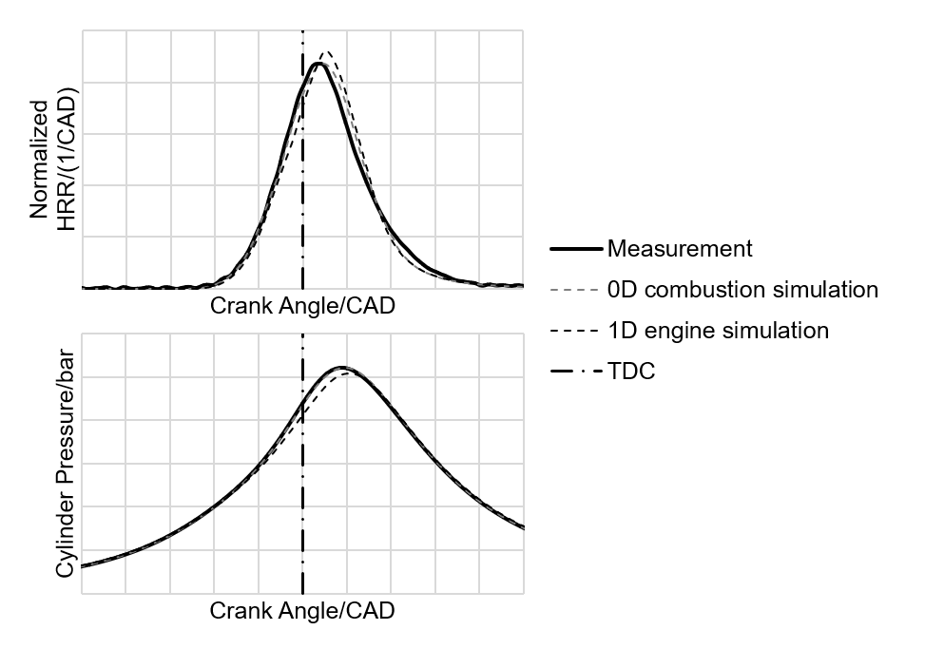
Modeling results
High load operation
0D combustion simulation is able to accurately predict HRR
Deviation of 1D engine simulation
  Differences in input parameters
  Trapped mass, EAR and mixture Temperature are not imposed
Deviation of 1D Simulation compared to experimental results
  Indicated efficiency: 0.3 percentage points
  Exhaust gas temperature: 4K
Notes:
Now we come to the Modeling results
The performance of the OCM was evaluated based on comparisons of the simulated HRR with 0D combustion simulation and 1D engine simulation with the HRR from the single cylinder engine measurements
In 0D combustion simulation the OCM is able to accurately predict the HHR
1D simulation shows some deviation despite the use of identical model parameters in both cases. The cause of the deviation are the differences in the OCM input parameters. The trapped mass, EAR and the mixture temperature at IVC are not imposed in the 1D simulation and might differ from measured values
For the 1D simulation additional parameters were compared to the experimental results. The indicated efficiency showed a deviation of approx. 0.3 percentage points and the exhaust gas temperature differed by approx. 4 K.

Slide 16
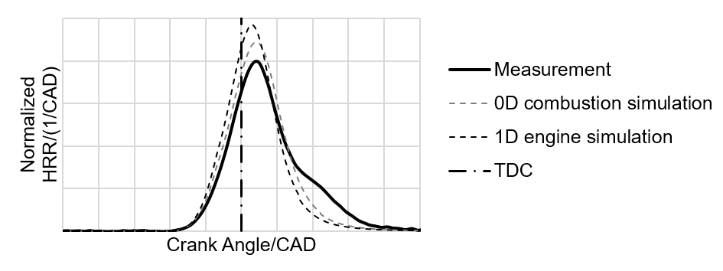
Modeling results
Part load operation
Major differences between experimental and simulated HRR
OCM is not able to predict retarded combustion
Possible reasons for deviation:
  Physical process or parameter is not accurately reflected in the model
  High cyclic variabilities
Notes:
In part load operation with an EAR at the lower limit of the investigated range major differ-ences exist between experimental and simulated HRR and differences between the two simulation models
The OCM is not able to predict the retarded combustion sufficiently well
This deviations could indicate that a physical process or parameter is not accurately reflected in the model or that model parameters are not properly adjusted. The high cyclic variability discussed in the “Experimental results” and the fact that average HRR were used for model parameter adjustment could also contribute to the deviations.
This deviation in Simulation lead to a difference of approx. 1.7 percentage points in indicated effiency compared to the measurement results.

Slide 17
Agenda
Introduction and objectives
Approach
Simulation procedure
Results
Conclusion and outlook

Slide 18
Conclusion and outlook
Conclusion
Investigation of hydrogen combustion in a large-bore gas engine
  Cyclic variations in the main combustion phase are caused by variation in the ID
  ID variation seems to be particularly high with hydrogen fueling
Quasi-dimensional model for hydrogen combustion
  High load operation can be predicted with decent accuracy
  Slower and retarded combustion at part load operation could not be depicted at all
  Strong sensitivity to input and boundary conditions
Notes:
In this study hydrogen combustion in a large-bore gas engine was investigated
The cyclic variations in the main combustion phase are caused by the variation in the ID and not by large variations in the combustion duration. The ID variation seems to be particularly high with hydrogen fueling compared to other fuels
To facilitate HyMethShip reformer-engine system optimization a quasi-dimensional model for hydrogen combustion was developed and calibrated with averaged measurement data from single-cylinder experiments.
The Evaluation of simulated HRR with measurement data showed that while high load operation can be predicted with decent accuracy, the slower and retarded combustion at part load operation could not be depicted at all
A comparison of the stand-alone OCM and the 1D simulation model showed a strong sensitivity to input and boundary conditions

Slide 19
Conclusion and outlook
Outlook
Future studies to evaluate the potential of hydrogen combustion in a large-bore engine
  Investigation of different ignition
  Investigation of central mixture formation
Combustion model improvement
  Improving accuracy of the model input parameters
  Procedure to deal with high cyclic variability
Notes:
An investigation of different ignition concepts, e.g. pre-chamber ignition or diesel pilot ignition, will be performed in a future study to evaluate the potential of hydrogen combustion in a large-bore engine. In order to eliminate mixture inhomogeneities as a possible cause for cyclic variations central mixture formation instead of port fuel injection should be investigated as well
In a next step the combustion model improvement will include improving the accuracy of the model input parameters, e.g. fuel and air mass in the cylinder and mixture temperatures at IVC.
Furthermore, the procedure for the model parameter adjustment needs to be revisited and possibly adjusted

Slide 20
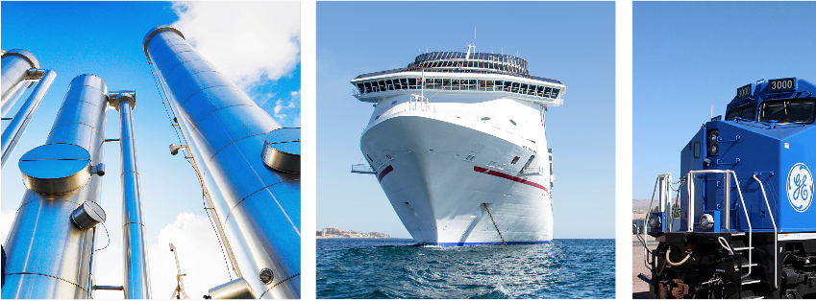










CONTACT:
Ao.Univ.-Prof. Dipl.-Ing. Dr. Andreas Wimmer • CEO and Scientific Director • Email: andreas.wimmer@lec.tugraz.at
LEC GmbH • Inffeldgasse 19 • A-8010 Graz, Austria • Phone: +43 (316) 873-30101 • Fax: +43 (316) 873-30102 • www.lec.at
Markus Roßmann
Thank you for
your attention!
Funded by comet
The K1 competence center LEC EvoLET is funded by "COMET - Competence Centres for Excellent Technologies Programme" of the Austrian Federal Ministry for Climate Action, Environment, Energy, Mobility, Innovation and Technology (BMK), the Austrian Federal Ministry for Digital and Economic Affairs (BMDW) and the Provinces of Styria, Tyrol and Vienna for the K1-Centre LEC EvoLET. The COMET Programme is managed by the Austrian Research Promotion Agency (FFG). • All information contained in this document is the property of LEC GmbH.

